Slide 1
What makes a great learner?
Think then…
Pair up and share

Slide 2

What makes a fantastic learner?
Share your responses with the class.

Slide 3

What is the picture of?
If you had to describe the picture in two words, which would you choose?
What is most interesting about the picture? Why?
How could this picture apply to your learning?

Slide 4



In pairs:
‘This just isn’t for me.’
‘I going to learn how to draw.’
‘I’m amazing at this already.’
‘I’ve never been good at Maths.’
‘I’m going to train myself to do this.’
‘If this way doesn’t work – I can always try something else.’
‘English is the only subject I’m good at.’
‘I’m much better at sport than school.’
‘I’m not clever enough to do this.’
‘I’m not good at this.’
‘I know I can do this.’
‘This might be difficult, but I am capable of getting this done.’
Sort the statements into two columns.
You can decide the title of the two columns.
Are there any phrases which you find yourself using regularly? Highlight them.
Notes:
Print for your classes

Slide 5
______________________ | _______________________
‘This just isn’t for me.’ | ‘I going to learn how to draw.’
‘I’ve never been good at Maths.’ | ‘I’m going to train myself to do this.’
‘English is the only subject I’m good at.’ | ‘If this way doesn’t work, I can always try something else.’
‘I’m much better at sport than school.’ | ‘I know I can do this.’
‘I’m not good at this.’ | ‘This might be difficult, but I am capable of getting this done.’
‘I’m not clever enough to do this.’
‘I’m amazing at this already.’
What is the difference between the two sets of statements?
How do you think someone who says each set would feel about challenges?
Why do you think it’s important to choose the statements that we say wisely?
Which set of statements do you think you use?
Notes:
The statement in green is harder as students may believe it should go with the other positive statements; however a very capable students who understand something quickly may fail to push themselves further, simply resulting in them coasting. Growth mindset is about pushing students passed whatever they are capable of and always learning and progressing even if they are already successful at a skill.

Slide 6
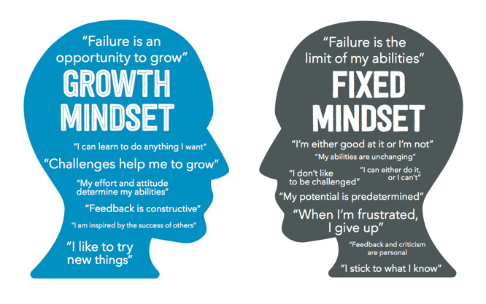
Mindset – what is it?
Everything we have talked about so far is to do with…mindset.
Mindset is our attitude, outlook and mentality toward life. It is the way we think about events in our lives, the way we deal with difficulties and challenges and it’s the way we think about ourselves. There are two different types of mindset.
Growth mindset is the belief that intelligence and skill are not things which we are born with.
It is the idea that we are always able to develop and grow our skills – both in things we enjoy and new things which we have yet to try.
Growth mindset is the belief that we can learn, through hard work and effort, to do anything. It sees failure as positive and something which we can learn and improve from.
A fixed mindset is the belief that we are born with a certain limit to our intelligence and a certain set of skills.
It is the belief that some people are better at things than others and that we cannot learn a new skill – we are simply ‘good’ at it already or not.
Someone who has a fixed mindset will not like to try new things and will avoid challenging themselves.
They will believe they are good at certain things and are bad at certain things.

Slide 7
  What have you learnt?
True
False
The brain is like a muscle. You must train it for it to be successful.
People who have a growth mindset set believe they are good at certain things and cannot learn anything new.
Changing your mindset is easy and takes no work!
Changing my mindset from fixed to a growth mindset will make me a more successful learner.
Having learnt a skill already means you don’t have to push yourself anymore.
You can learn any new skill through hard work, effort and by believing you can.
True
False
True
False
True
False
True
False
True
False

Slide 8
How could you use growth mindset?
Write down one ‘growth mindset’ statement you are going to use this term on your ‘growth’ card.
These will be collected and handed back and displayed. ☺

Slide 9

Growing My Mindset
I am going to use the statement:______________________________________________________________
This is because I want to improve my:___________________________________________________________________
Growing My Mindset
I am going to use the statement:______________________________________________________________
This is because I want to improve my:___________________________________________________________________
Notes:
Print and give out

